Slide 1


AWARENESS CLUB
ZERO HUNGER
FOOD WASTE

Slide 2
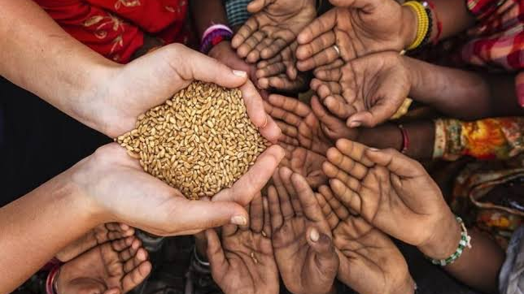

Slide 3
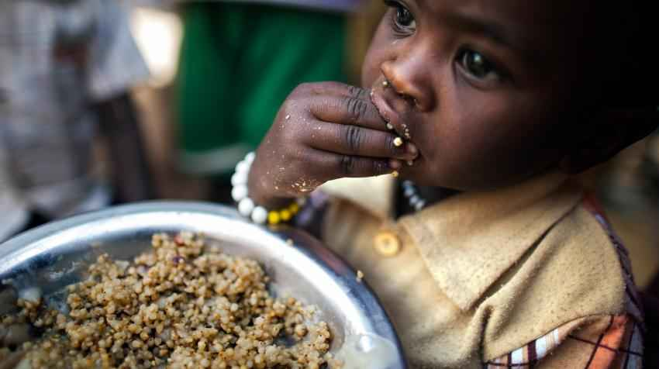

Slide 4


